Slide 1
CHECKPOINT REPORT
Predictive Maintenance for
Metro Climate & Air Systems
Data understanding and pre-processing complete. Modelling underway.
Joseph (Neil) Truskolaski
MetroPT-3 Air Production Unit · 1,516,948 readings
4 of 8
16,773
0.58
4 / 4
weeks elapsed (to 18 Jul)
modelling windows
best F1 so far
events detected

Slide 2
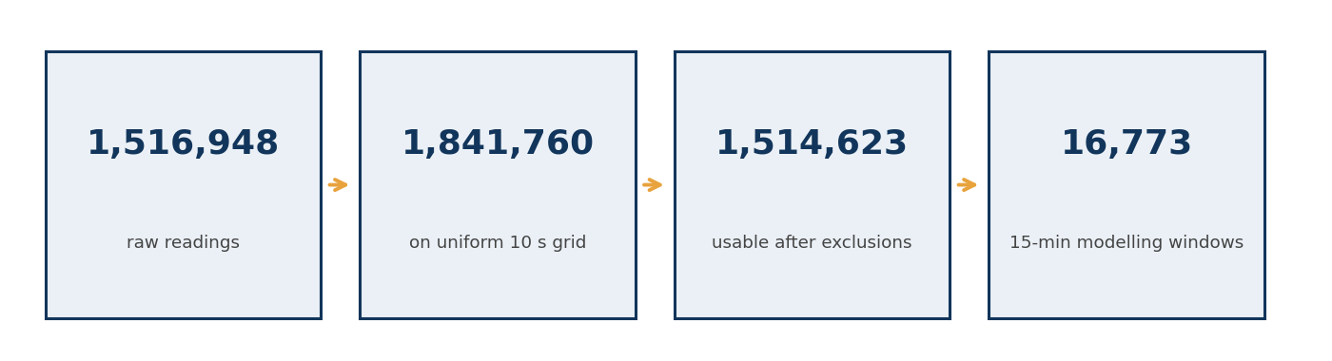
Where the Pipeline Stands
PROGRESS
Four stages complete. The data reduction is the headline.
Data understanding
Pre-processing
Cycle store / windows
Clustering
Anomaly detection
Early warning
DONE
DONE
DONE
DONE
IN PROGRESS
OPEN
1.5M raw readings reduce to 16,773 analysable windows: a 90x reduction that preserves the cycle and duty statistics a leak acts on

Slide 3
Three Cleaning Decisions, Three Reasons
CLEANING
Each choice was made against a specific property of this sensor stream.
1
2
3
Flag gaps, never interpolate
Correct offsets only where zero is expected
Median filter, not mean
909 hours of the 213-day record are missing across 331 gaps. Interpolating would invent smooth, well-behaved data exactly where the machine was out of service, teaching the model that the smoothest data is the most normal.
TP2 and DV_pressure rest at -0.012 and -0.020 bar: transducer bias. H1 rests at 8.64 bar because that is a real pressure. A blanket idle-median correction would have destroyed H1 entirely.
A 5-sample median removes transient spikes while preserving the sharp edges of state transitions. A mean filter smears those edges, and the edges are what define a compression cycle.
909 h
0.11%
97k/s
of record missing, now flagged
sustained frozen sensor holds
cleaning throughput

Slide 4
The Compression Cycle Broke as a Unit of Analysis
FINDING 1
The proposal was wrong about this, and the reason is physically interesting.
What we expected
What actually happened
Aggregate 1.5M readings into ~16,900 compression cycles and model each cycle. A leak shows up as longer refills and shorter intervals.
During a failure the compressor stops cycling and runs continuously. There are almost no cycle boundaries inside the events we most need to model.
10,974
3
cycles found in the cleaned record
of those cycles begin inside a failure window
The fix, and why it is better: the modelling unit is now a fixed 15-minute window, with cycle statistics carried in as features. Cycles still describe the physics, but the window never disappears when the machine changes behaviour. The absence of cycling is now itself a measurable feature rather than a hole in the data.

Slide 5
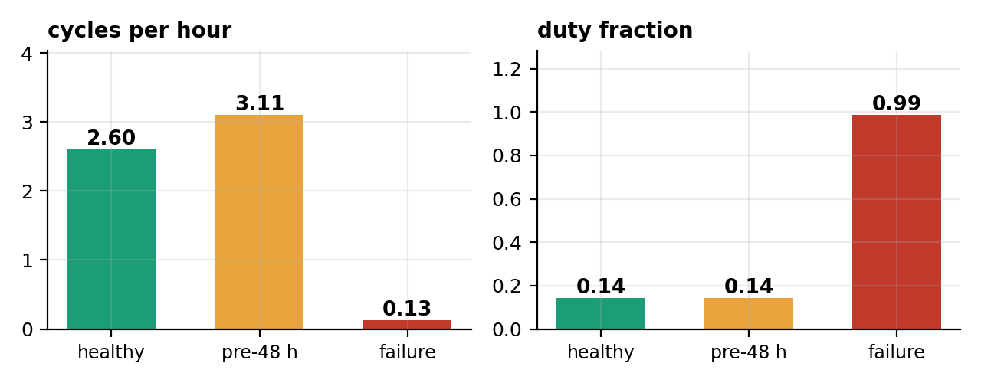
A Three-Stage Degradation Signature
FINDING 2
Cycling frequency moves first. Duty cycle moves only at onset.
HEALTHY
PRE-FAILURE (48 h)
FAILURE
2.60 cycles/h
3.11 cycles/h ( +20% )
0.13 cycles/h ( -95% )
Why this matters: duty cycle is flat at 0.14 right up to onset, so any duty-based alarm has zero lead time. The early signal lives in cycle frequency.

Slide 6
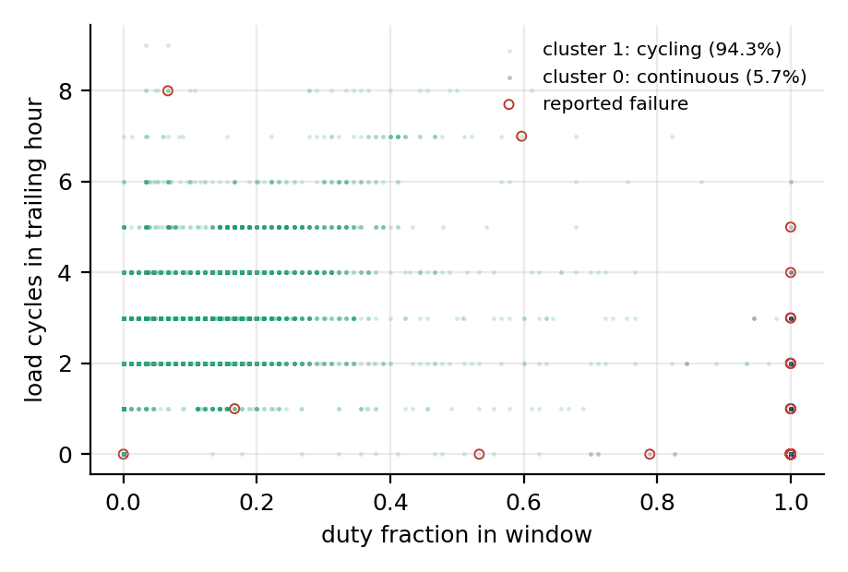
Unsupervised Structure Confirms Two Regimes
CLUSTERING
k = 2 chosen by silhouette (0.676). No label was used to find this.
Cluster 1: cycling
94.3% of windows · duty 0.11, 2.6 cycles/h
0.03% failure rate
Cluster 0: continuous run
5.7% of windows · duty 1.00, 0.004 cycles/h
34.0% failure rate
98.5% of failure windows land in cluster 0
But only 34% of cluster 0 is a reported failure. Continuous running is necessary, not sufficient.
The clustering found the fault regime without being told it existed. That is the strongest validation we have that the feature set encodes the physics.

Slide 7
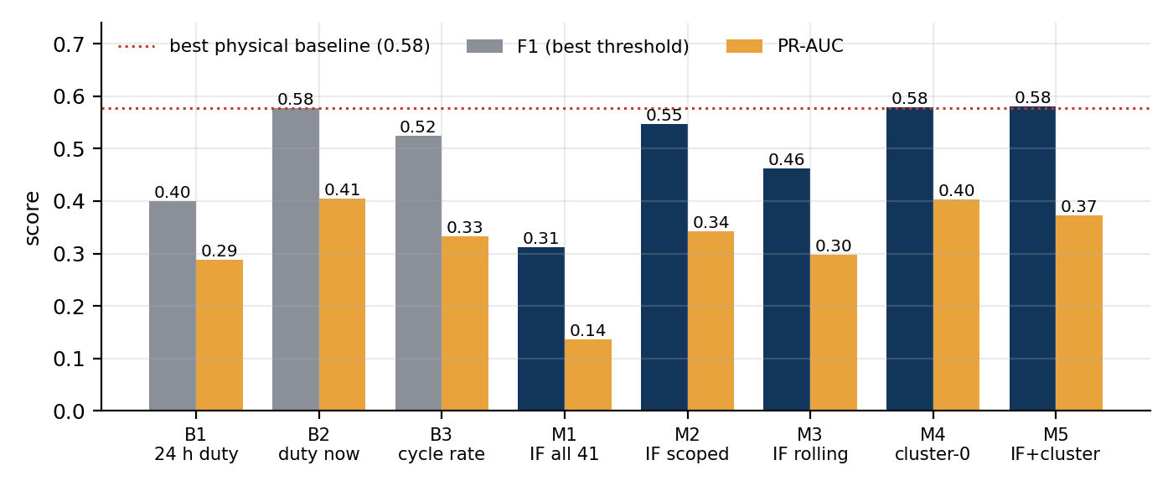
The Sophisticated Model Lost to the Simple One
RESULTS
We could have retuned until the numbers improved. Diagnosing the failure was worth more.
Diagnosis
Isolation Forest on all 41 features scored worse than a single duty threshold (F1 0.312 vs 0.577)
Cause: mean duty rises 50% from the Feb-Mar training window to the test period. The detector spends its alarm budget on seasonal drift, not on faults.
0.312 → 0.546
0.58
4 / 4
F1 after scoping to 14
physics-based features
three methods tie here / gated model preferred for its tunable score
events detected by every
model that we tested
Conclusion: concurrent detection is effectively solved by physics. Adding model complexity buys almost nothing. So the remaining research value is not here.

Slide 8
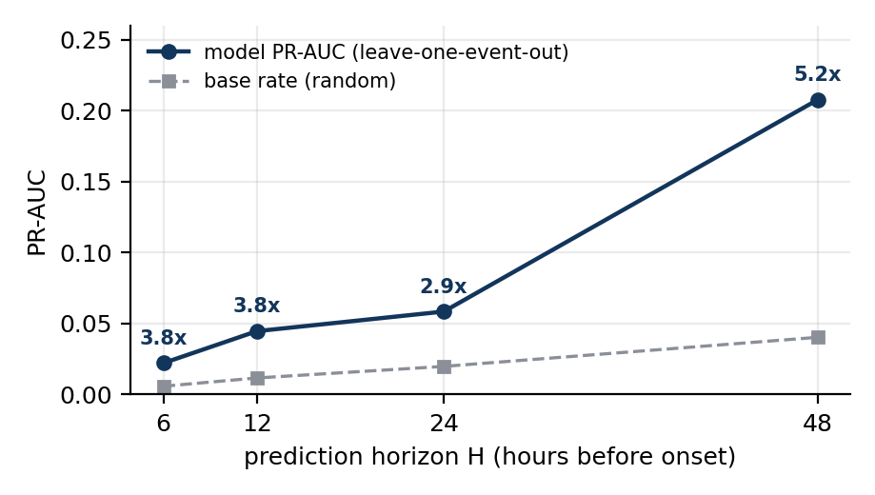
The Real Remaining Problem: Lead Time
OPEN QUESTION
Detection at onset is easy. Prediction before onset is not.
How this was tested
Every window inside a failure was removed, so the model cannot cheat by detecting the event it is meant to predict.
Validation is leave-one-event-out, because four events cannot support a random split.
PR-AUC is reported against base rate, since at 0.6% prevalence a raw PR-AUC of 0.02 can still be a 3.8x lift.
Where this leaves us: the model beats chance at every horizon (2.9x to 5.2x lift) and flags all four events, but absolute precision is low. There is real early signal and it is not yet strong enough to act on. Closing that gap is the work of the remaining weeks.

Slide 9
Challenges and the Backup Plan
RISKS
Named now, with a decision rule for when to switch.
1
Label incompleteness
2
Four events only
Two thirds of cluster 0 is unreported. Precision is capped by the labels, not the model.
Every supervised number rests on four positives. Variance dominates point estimates.
Mitigation: Report unlabelled high-score episodes separately, against confirmed events.
Mitigation: Leave-one-event-out throughout. Report spread, never a bare mean.
3
Concept drift
4
Early warning may not reach usable precision
Mean duty rises 50% from training to test period and has already broken one model.
Current lift is real but precision is low at every horizon.
Mitigation: Scoping to 14 physical features, which recovered F1 from 0.312 to 0.546. A rolling 30-day reference was also tried and underperformed; see report §9.1.
Mitigation: Fall back to change-point detection on the CYCLE-RATE series, not duty: duty carries no pre-onset signal, so a duty-based change point would inherit zero lead time.
Switch rule: if week 6 leave-one-event-out PR-AUC lift stays below 3x at the 24-hour horizon, we stop tuning and ship the change-point fallback.

Slide 10
Four Weeks to the Finish Line
Scope deliberately narrowed to the one question that is still open.
19 July to 15 August 2027
WEEK 5 · 19-25 JUL
WEEK 6 · 26 JUL-1 AUG
WEEK 7 · 2-8 AUG
WEEK 8 · 9-15 AUG
Early-warning features
Model and decide
Efficiency and ablations
Write up and ship
Build cycle-frequency and pressure-recovery features targeted at the pre-failure stage.
Gradient boosting at 24h and 48h horizons. Apply the switch rule at week's end.
Full-stream throughput, per-window latency, feature ablations.
Final report, reproducible repository, dashboard mock.
Dropped from scope: the LSTM autoencoder. Isolation Forest already showed that added capacity does not beat physics on this signal, so the deep model would consume a week to answer a question we have answered.
The big picture: every task above serves one outcome, giving a maintenance planner enough warning to pull a train before it strands passengers mid-line.
Joseph (Neil) Truskolaski · MetroPT-3 Checkpoint

